Slide 1
Planning Your
Fieldwork Placement
Sarah C. Beshers, Ph.D.

Slide 2
Contents
Purpose (Why?)
Options (What? Where? When?)
Eligibility (Who?)
Student’s Role
College’s Role
Placement Criteria
Logistical Considerations
Identifying Priorities
Steps in Planning Process

Slide 3

Why?
A culminating experience
A learning opportunity
A career jumpstart
A supportive transition

Slide 4
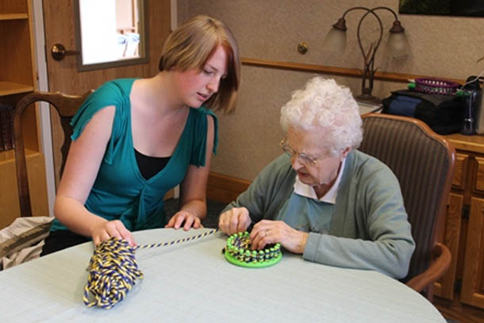
What? Maybe clinical….
Hospitals
Private practice
Public clinics
Rehab facilities
Nursing homes
Visiting nurses
Imaging facilities
???

Slide 5


What? Maybe non-clinical….
All the clinical settings
County health departments
State DOH
Colleges
Non-profits
Social service agencies
Worksite wellness
???

Slide 6


Where?
Your hometown
Your home away from home
Anywhere else in NYS
Anywhere else in the U.S.
Anywhere else in the world

Slide 7
Should I Stay in Cortland?
Possible Pros
  Friends
  Lease
  Bars
  Sports
  Pre-graduation nostalgia (tears)
Possible Cons
  Not an amazing adventure
  Weaker networking
  Not where you want to work after graduation
  So…..consider a housing plan that gives you flexibility in the spring semester!

Slide 8
Eligibility
GPA is at least 2.5
Good academic standing (not on academic probation)
No incomplete courses or late grades (INCs and LGs)
All required health courses are completed as well as nine credits of health electives

Slide 9

Placement Planning
Lots of decisions!
All yours!
Might take forever!
Might be frustrating!
We’ll help.
But in the end, it’s on you.
So get started!

Slide 10
Student’s Role
Take the initiative
Imagine and reflect
Research
  Internet
  Prior placement lists
  Alums
  Parents and family friends
  Mentors
  Interviews
Seek guidance
Know your worth
Do the leg work
  If necessary, be persistent!
  Use multiple strategies!
Polish your resume
Meet the deadlines

Slide 11
College’s Role
Provide structure
  Advising meetings
  Fieldwork Manual
  Fieldwork website
  Mandatory meetings with the fieldwork coordinator
  Forms
    Intent to do Fieldwork
    Fieldwork Application
  Procedures
  Confirms that the placement is appropriate
Provide advice and suggestions
  Fieldwork coordinator
  Advisor
  Prior placement lists
  Career Services
  International Programs Office (IPO)

Slide 12
College’s Role, cont.
Legal arrangements
  Field Experience and School Partnerships Office
  Affiliation agreements with the agencies
    “the contract”
    Only if requested by the agency for liability insurance
  Confirmation letters
Additional support for overseas placements
  International Programs Office

Slide 13
College’s Role, cont.
Fieldwork Coordinator: Sarah Beshers
Contact person in the Field Experiences and School Partnership Office: Mary Reagan

Slide 14
Useful Criteria for a Placement
Meets the minimum required criteria
  Clear health focus
  At least one health professional on staff
  A lot going on
Lots of professionals
Lots of passion and commitment
Not tiny
Not your family’s business
Not a place where you have already worked
Challenges to meet

Slide 15

Logistical Considerations
Which semester?
  No vacations during fieldwork!
One placement or two?
A back-up placement?
Transportation?
Financial support?

Slide 16


What is your top priority?
  Get a job?
  Shadowing hours for grad school?
  Find out if you actually enjoy what you think you enjoy?
  Explore a range of fields?
  Work with a specific population?
  Have an adventure?

Slide 17
Planning Steps
With advisor, identify the preferred semester for fieldwork and adjust as necessary based on academic progress
Planning starts two semesters in advance
  Fieldwork semester -2
  Fieldwork semester -1
  Fieldwork!

Slide 18
Steps during FW Semester -2
  Attend the MANDATORY fieldwork planning meeting
    Spring, 2020: 2/25/19
    Summer, 2020:
    Fall, 2020:
  Complete the Fieldwork Intent Form
  If it would be helpful, meet with the fieldwork coordinator to discuss your interests, concerns, and questions.

Slide 19
Last, and most important
  4. Research potential placements!
    Call! Email! Call again! Email again!
    Study agency websites
    Interview the agencies
    Identify a first choice and a back-up
    NOTE: If you’re planning to do fieldwork in your home community, you’ll need to use either the summer or the winter break to do these interviews
      FW in spring semester → interviews in summer
      FW in summer or fall semester → interviews in December/January

Slide 20
Agency Interviews
Don’t be scared or intimidated—you’re a valuable asset!
Great practice for job interviewing
  Take a list of questions
  Take notes as necessary
  Bring a current and polished resume if you haven’t already provided one
You’re interviewing them too
  Share your interests
  Satisfy your curiosity

Slide 21
Agency Interviews, cont.
Don’t discuss first choice vs. second choice
Listen to your gut feelings—positive vibe?? Do you and the potential supervisor have a good connection?
Explain the SUNY-Cortland fieldwork program
  Use the Fieldwork Manual
  16 academic credits
  Mention the project!
  Be clear about our expectations regarding clerical work
  Refer them to the fieldwork coordinator for more information

Slide 22
Steps During FW Semester -1
Submit application on or before the due date, along with the Prior Felony Inquiry Form
  Spring, 2020: 8/26/19
  Summer, 2020:
  Fall, 2020:
Promptly respond to all communication from the fieldwork coordinator and the Field Experience and School Partnerships Office

Slide 23
Fieldwork Semester -1, cont.
3. Attend the MANDATORY fieldwork orientation meeting with the fieldwork coordinator
  Summer, 2019: 4/15/19
  Fall, 2019: 4/29/19
  Spring, 2020: 11/4/19
4. Receive the official placement confirmation letter from the Field Experience and School Partnerships Office in your Cortland email account

Slide 24
Fieldwork Semester -1, cont.
5. Register for fieldwork (HLH 499)!!
  Two quarters of eight credits each, but they are sometimes lumped together for registration
6. If necessary,
  Complete the procedure to get medical clearance from the host agency
    Don’t procrastinate! Lack of medical clearance means a late start to fieldwork! Attendance issues ☹!
  Attend the agency’s orientation(s) and training(s)

Slide 25
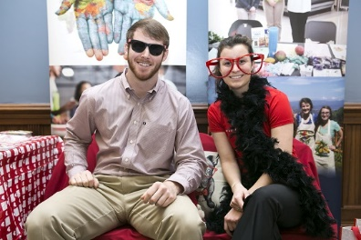
Have fun! ☺

Slide 26
Images
OT: http://imgarcade.com/1/occupational-therapy-elderly/
Healthy Neighborhood Program: http://www.cayugacounty.us/Community/Health/EnvironmentalHealth/HNP.aspx
Cupcake: http://www.glutenfreecanteen.com/2012/04/05/chocolate-sundae-cupcakes-gluten-free/
Hometown: https://hometownleads.wordpress.com/about/hometown-vector/
Decision making: http://www.pazarlamamakaleleri.com/tag/satis-makale/
Fun: https://www.samford.edu/publichealth/news/Dietetic-Internship-and-Dept-of-Public-Health-Go-Red

